Slide 1
CSC 102: Introduction to problem Solving.
PSEUDOCODES TO CLASS PROJECTS WEEK 2
BY: DAVID USIM

Slide 2
PROJECT I
BEGIN
SET Aminat at (0,0)
MOVE three blocks to the east to block (0,3)
IF flower is there:
PICK-UP flower
MOVE two blocks to the south to block (2,3)
IF space is vacant:
DROP flower there
ELSE:
RETURN flower to original position
IF flower is not there:
MOVE to block (3,4)
END

Slide 3
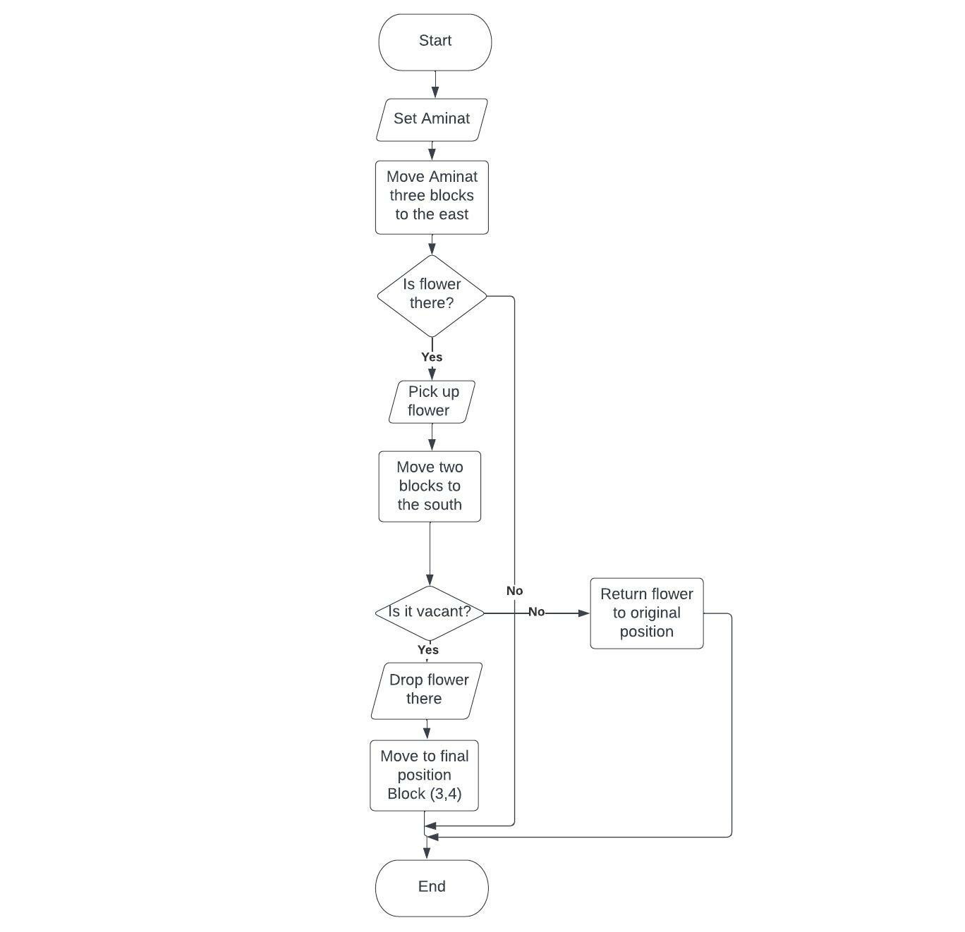
FLOWCHART

Slide 4
PROJECT II
BEGIN
LET employees be from A to O
FOR example when A is Employee 1, B is employee 2 and so on
LET members A to O be members of the set U
NOTE U equals employees of the Usim Foundation
INPUT username and password
IF successful
INPUT fingerprint and facial recognition
ELSE:
PRINT Unauthorized user! Kindly step away from the system
IF a staff of the company:
PRINT Welcome to the Usim Foundation
ELSE:
PRINT Unauthorized user! Kindly step away from the system
LET employer be notified when an unauthorized use is discovered
END

Slide 5
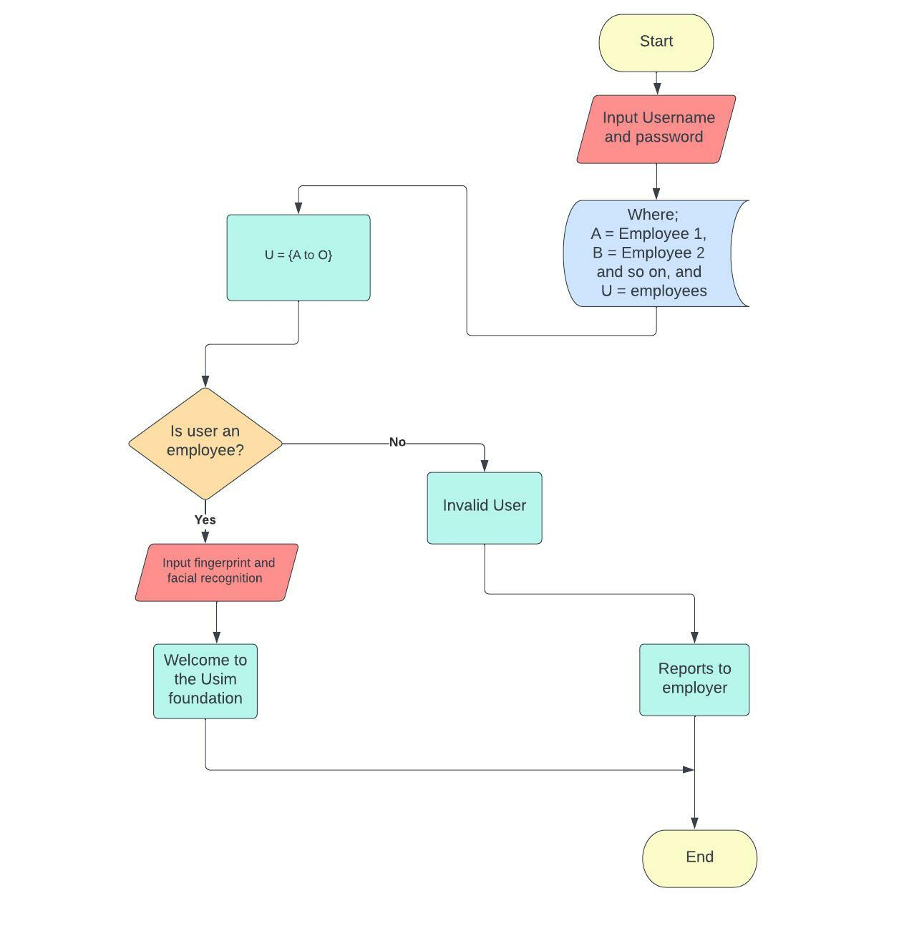

Slide 6
PROJECT III

Slide 8
PROJECT IV

